Slide 1
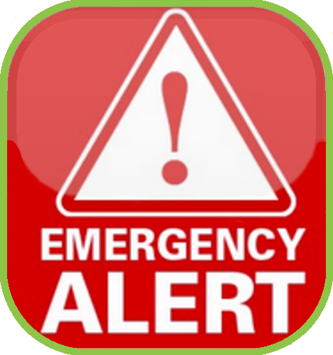
ALERT
PRESENTED BY:
IPDG Ric Houser
937-520-1936 Cell
RANGER3201@GMAIL.COM

Slide 2
PURPOSE
The Lions ALERT Committee’s primary goals are outreach and communication to communities and Lions Clubs on how to prepare for the possibility of a disaster or other severe event
A secondary goal is to assist in relief support as Lion resources are available and willing
In addition, all districts are encouraged to apply for LCIF Lion’s ALERT grants yearly
Another secondary goal is that this committee’s members would assist in coordinating any Multiple District or District Lion ALERT grants

Slide 3
WHAT CAN DISTRICT CONTACT DO
Create Emergency Contact Lists
Communicate with Community Emergency Leaders
Help Set Up Contacts During Emergencies
Work With District Governor on Emergencies
Help Write LCIF Emergency Grants

Slide 4
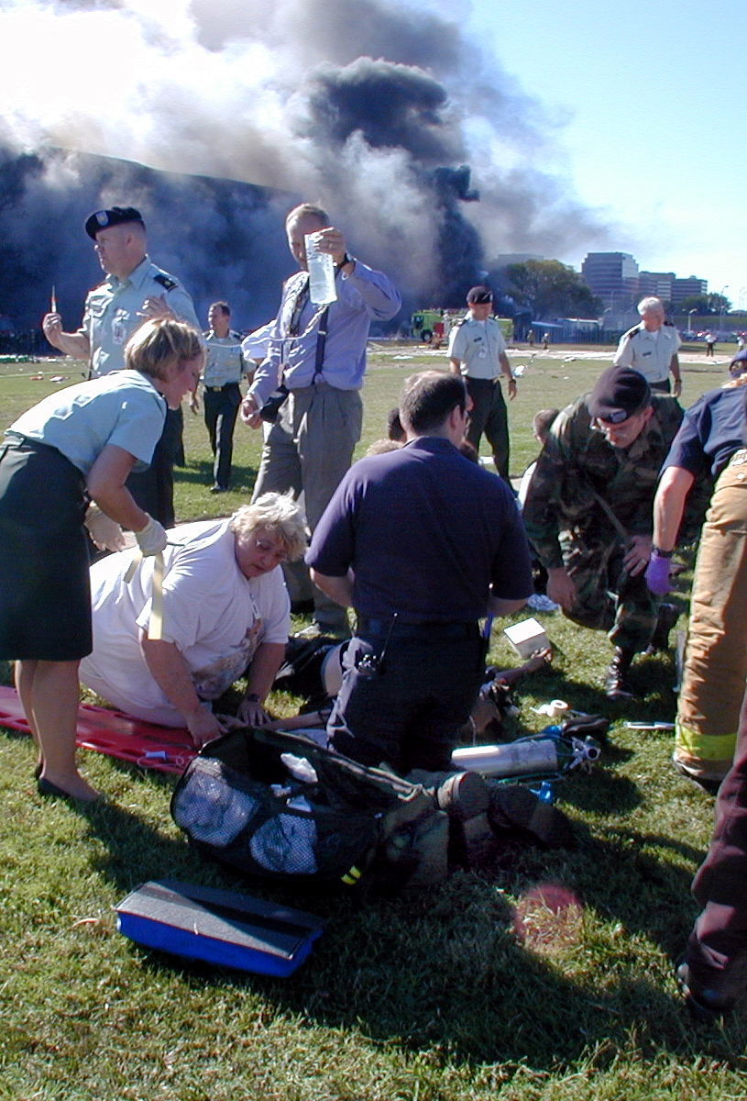
CLUBS CAN PARTICIPATE
Create Emergency Contact Lists
Communicate with Community Emergency Leaders
Help Set Up Contacts During Emergencies
Work with Club President and Club to Help Community in Emergencies

