Slide 1
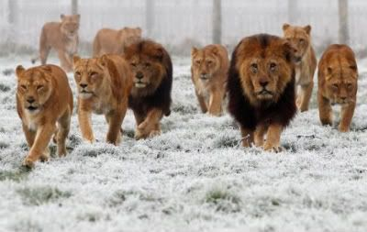
ZONE AND REGION CHAIRPERSONS
Presented By:
IPCC Lydia Houser
(937) 609-6594
LMHYOYO@AOL.COM

Slide 2
ROLES
Important role as a key district liaison in support of the clubs in your zone
Communicate with the club officers in your zone
There to support clubs and share the zone meeting dates and locations so clubs may also plan ahead
Lead the Zone meetings
Attend and publicize Club activities
Be present, provide reports and participate at district Cabinet meetings
Encourage and invite the members of clubs in your zone to attend any or all of the major convention and learning events to build friendships and knowledge beyond their club
Link between the district and the clubs
Assist clubs in need, if asked
OH6 has two Regions; Regions Chairs support Zone Chairs and district

Slide 3
MEETINGS
Most zone meetings are scheduled on a quarterly basis
Tied to the dates of the district cabinet meetings to facilitate communication of time-sensitive information
Zone chairs conduct meetings; Region chair supports
Attend a club meeting for clubs in the Zone/Region
Report club info back to Cabinet

Slide 4
UNDERSTANDING THE NEEDS OF THE CLUBS
You help clubs achieve excellence in:
Leadership development
Membership growth
Meaningful community service
Fundraising efforts for LCIF
Help strengthen struggling clubs

Slide 5
Region 1
Region 1 Chair – PCC Lydia Houser
ZONE 1 – Rob Brock
Camden, Eaton-Lewisburg, Germantown, Oxford, West Alexandria
ZONE 2 – Vickie Moody
Dayton, Mad River, W E Stebbins Leos, Miamisburg, Northmont, Northmont Leos, Vandalia, West Carrollton
ZONE 3 – Patrick Bookman
Carlisle, Lebanon, Lebanon Leos, Madison, Mason, Monroe, Monroe Leos, Springboro, Waynesville
ZONE 4 - David Dennerll
Bethel, Cincinnati Host, Cincinnati Kenwood, Cincinnati Western Hills, Goshen, Northeastern, Northeastern Leos, Ross

Slide 6
Region 2
Region 2 Chair – Lion Beth Cauley
ZONE 5 – Brad King
Beavercreek, Bellbrook, Fairborn, Fairborn Leos, Jamestown
ZONE 6 – Jerry Spahr
Blanchester, Good Hope, Jeffersonville, New Holland, Port William, Sabina, Washington CH, Wilmington
ZONE 7 – Beatrice Fryman
Greenfield, Leesburg, Liberty Twp, Lynchburg, Martinsville, Mowrystown, White Oak Leos, New Vienna, Paint Valley
ZONE 8 – Donald Pursley
Georgetown, Manchester, Mt Orab, Ripley, Ripley Leos, Seaman, West Union
ZONE 9 – Richard Young
Beaver, Chillicothe Evening, Zane Trace M.S. & H. S. Leos, Frankfort, Minford, Piketon, Waverly, Waverly Leos

Slide 7
REGION AND ZONE CHAIRS
Major help for the district governor in providing them a link to the clubs
Here to help clubs and members
Information central contact
Cheerleader

