Slide 1

Global Membership Approach/north American membership initiative and THE OHIO PLAN
PCC/IPDG Lydia Houser
(937) 609-6594 C
LMHYOYO@aol.com

Slide 2
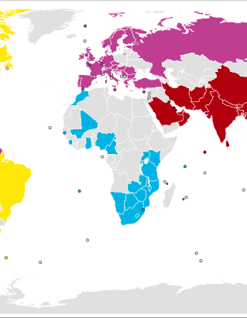
GLOBAL MEMBERSHIP APPROACH (GMA)/NORTH AMERICAN MEMBERSHIP INITIATIVE (NAMI)
LCI introduced the North American Membership Initiative (NAMI) in 2020 but changed to Global Membership Approach. Membership is important to all of us and our clubs.
The North American Membership Initiative pilot began in 2018
  Help jump start the membership growth and retention in the United States and Canada.
    Successful -- decided the pilot and its objectives will continue worldwide and now be known as Global Membership Approach. The Global Membership Approach will be delivered and supported by the Global Action Team.
Notes:
LCI introduced the North American Membership Initiative (NAMI) in 2020 but have changed it to Global Membership Approach so you will hear both talked about coming out from LCI. Membership is important to all of us and our clubs.
The North American Membership Initiative pilot began in 2018 to help jump start the membership growth and retention in the United States and Canada. As a result of that success, it was decided that the pilot and its objectives will continue on a worldwide basis and now will be known as the Global Membership Approach. The Global Membership Approach will be delivered and supported by the Global Action Team.

Slide 3

OBJECTIVES
Global Membership Approach objectives align with the original North American Membership Initiative Objectives. Objectives are:
  •To rejuvenate districts with new clubs
  •Revitalize clubs with new members
  •Re-motivate our existing members with new fellowships and exciting service
Notes:
The Global Membership Approach objectives are aligned with the original North American Membership Initiative Objectives. The objectives are:
•To rejuvenate districts with new clubs
•Revitalize clubs with new members
•Re-motivate our existing members with new fellowships and exciting service.
These three objectives continue driving us to our goal of increasing the number of Lions. Global Membership Approach combines a strategic process and a set of available resources. The goals are focused on membership growth through new club development.

Slide 4
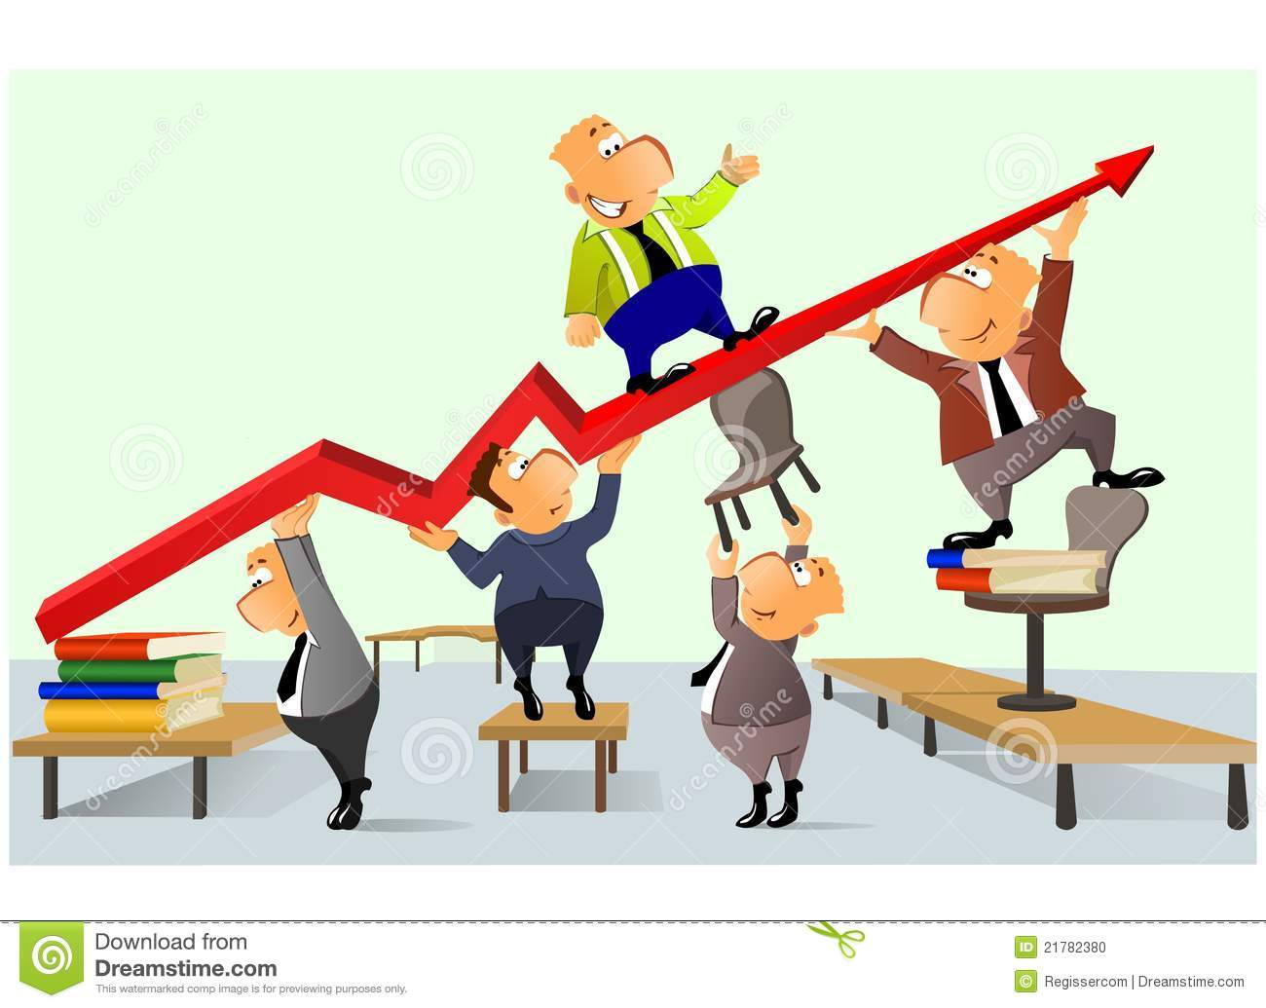
PROCESS
4-step process is universal, and customizable based on needs:
1. Build a Team
2. Build a vision
3. Build a plan
4. Build Success
The goal is positive membership growth. This goal is fundamental to the broader goal of One Lion: to be the global leader in community and humanitarian service.

Slide 5

WHY AND JUST ASK
Program is of major importance to LCI and Ohio Lions. We lose more members than we bring in. We are losing clubs that have been around for many years. To remain a viable service organization, we must recruit and retain members.
We need to “Just Ask” others to join us.
  Find out what is important to them.
  Think “outside of the box” to move forward. New ideas can bring in new members.
Keep current members involved and an important part of your club.
Notes:
This program is of major importance to LCI and Ohio Lions. We continue to lose many more members than we bring in across Ohio and North America. We are losing clubs that have been around for many years but have not been able to recruit and retain members. If we are to remain a viable part of being a service organization, we must work to recruit and retain our members.
We need to ask, “Just Ask” others to join us. Find out what is important to them and determine if it is something that will work for your club as a project. It is time to think “outside of the box” to move our terrific organization forward. New ideas can bring in new members. Also, keep our current members involved and an important part of your club.
We have seen numerous initiatives over the years to improve our membership numbers and continue to grow. This not only allows us to accomplish our projects, raise funds and perform service, it allows us to do more. In these times, there are many in need of our services and it never hurts to have another helping hand to get our work done.
I am not asking you to go out and start another whole program to make our district grow. I am asking each club to take the Ohio Plan and utilize it this year. Do not just go look at the plan; you need to read and then go accomplish each step in the plan. The Ohio Plan is 10 pages and half of that document is templates that a club can use so they do not have to create letters, forms, etc. It has been proven to work if you utilize it and follow it all the way through the process. Remember, even if you get one new member, you have been successful!

Slide 6
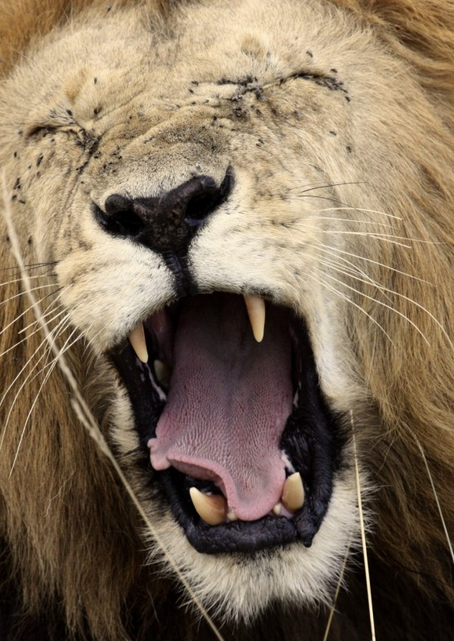
EXPLAIN WHAT LIONS CLUB DO
Lions Club Community Focus:
  Youth Development Projects
  Temporary Assistance for those in need
  Disaster Relief
  Medical Initiatives & Research
  Assistance for the Disabled
  Building Community Infrastructure
  Community Festivals/Events/Activities

Slide 7
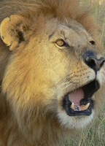
EXPLAIN WHAT LIONS CLUB DO (CONT)
Member Benefits:
  A sense of belonging
  Developing personal skills
    Public Speaking
    Project Management
    Finance Control
    Leadership Development
  Making Lifelong Friends
  Satisfaction of helping others in need
  Enjoying the company of others who feel the same way

Slide 8

THE OHIO PLAN
A Project that is a Structured Method for Recruiting New Members.
Notes:
Today we want to discuss a plan that was developed within Ohio and continues to be a proven plan to recruit new members
What is needed is a step-by-step guide, and that is what the Ohio Plan provides.

Slide 9

THE OHIO PLAN
Works Every Time it is Used !
But There is a “CATCH”
You MUST follow “..the Plan”
Notes:
NOT ONLY DOES IT WORK,
IT WORKS EVERY TIME IT IS APPLIED CORRECTLY.
However, there is a CATCH.
To paraphrase a song by Frank Sinatra…….
YOU GOT TO DO IT OUR WAY !!!
Over the years we have probably made ever possible mistake, and some of
Them more than once. Since the mistakes have already been made,
you are under no obligation to repeat the same errors.
FOLLOW THE TEMPLATE WE’RE PROVIDING
AND YOU’LL BE SUCCESSFUL.
As a starting point, there are two things you must accomplish.

Slide 10
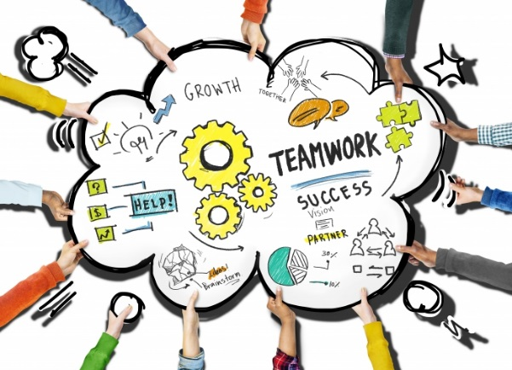
ACHILLES HEELS
Must Treat Recruiting as a Project.
Must Keep Charlie/Mary Happy.
Notes:
FIRST, YOU MUST TREAT RECRUITING AS A PROJECT.
- We’ve all been at meetings where the President or Membership Chairperson stands up and says
OK, next meeting we’re going to recruit new members. Everyone bring a guest. And what happens, typically very little.
- RECRUITING CANNOT BE HANDLED IN A LACKADASICAL MANNER.
- This means there has to be a Chairman + assistants
- You wouldn’t run a fund raiser or community service project without planning, and recruiting is no different.
What is this about keeping Mary happy?
- Well, the main reason people don’t invite people to join the Lions is fear of rejection. Here’s the thought process, “Joe and I are good
friends. If I ask him to attend a Lions meeting and he says “no,” it could ruin everything. It is not worth the risk.”
- And if I do ask someone, I won’t make any cold calls.
- To get my cooperation you must make me feel comfortable. You have to promise me that I won’t have to make any cold calls, and
maybe not even have my name used when talking to people.
- If you agree to this, then I’ll give you some names.

Slide 11

KEY ACTIVITIES
Gather Names
Communicate
Plan Meeting
“M - DAY”
Follow-up
Notes:
THESE ARE THE KEY ACTIVITIES IN RUNNING A
SUCCESSFUL NEW MEMBER NIGHT.
- - recite the categories - -
WE’LL DISCUSS THE PRIMARY TASKS IN EACH OF THESE IN A MINUTE,
BUT FIRST I WANT TO MENTION THE PRIMARY THING
THAT OVERRIDES, OR TRUMPS, EVERYTHING ELSE.

Slide 12
PRIME CONSIDERATION
You Only Get ONE CHANCE to Make a Good First Impression.
Notes:
EVERYONE HERE KNOWS THIS, but it’s amazing how
often this concept gets forgotten.
So EVERY TIME you get ready to make a decision,
ask yourself “How are the Guests going to react to
this situation?”
The prospective members really are your guests,
and you and the club must show them every possible
hospitality.
This is CRITICAL to getting them to decide to join
Your Lions club.

Slide 13

GATHER NAMES
Recruiting Wheel
Target Important Groups
Review Process
Fill-in Information Gaps
Notes:
TO HOLD A MEMBERSHIP NIGHT, YOU NEED THE NAME OF PROSPECTIVE MEMBERS.
LCI provides two good resources, the Recruiting Wheel and the Get-a-Member Referral form. Both of these are in the HCI and the reference section of this report. Go through the categories one at a time and have your members write the prospective names on 3x5 cards.
2. Target groups (photography, travel, diversity, etc.)
- the BEST POSSIBLE target is the parents of graduating seniors because they will now have available evenings.
- other groups also can join the lions to expand their horizons.
3. Review names gathered
- After the prospects are written, collect the cards and review names.
- You need to reconsider anyone who might be a disruptive influence.
4. There will be gaps in addresses, phone numbers, emails, etc.
- The committee will have to fill-in the gaps.

Slide 14

COMMUNICATIONS
Letter of Introduction
Telephone Call
Reminder Call
Post Card
Notes:
AFTER THE NAMES ARE COMPLETE…..
FIRST YOU SEND A LETTER OF INTRODUCTION.
- We provide some sample letters for your use.
- Invite people to the M-night & provides info.
- You also send an advertising brochure or provide club website if you have one (make sure it is up to date!)
7-10 DAYS LATER YOU GIVE THEM A CALL.
- Reinforces the Invitation & answer questions.
- Tell them it won’t be a long event, 1-1/2 hours max.
- This call is normally done by the committee.
3. REMINDER CALL, 2/3 days before event.
- Hopefully the sponsor will make this call.
- He/she can also offer the guest a ride.
4. You can also send out a written postcard reminder before the event.

Slide 15
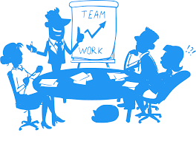
PLAN THE MEETING
The Venue
The Menu
Speakers
Decorations
Other…….
Notes:
THERE ARE MANY THINGS THE COMMITTEE WILL NEED TO TAKE CARE OF.
VENUE: Best choice is a restaurant with a private room.
- Rooms at libraries, community centers, city halls also work.
- Need some privacy and minimal BACKGROUND NOISE.
2. MENU. Best choice is a buffet. Easier to provide a variety of foods, including vegetarian.
3. Schedule the SPEAKERS, but make sure they understand the rules and the time limit. Suggestion: have speaker give an overview of your local projects and a Lion show a video about LCI. These videos are available from LCI or contact District GMT chair for information. Concentrate on your local club but make sure to have a brief explanation on how Lions are an International Service Organization.
Dig up all your CLUB FLAGS, banners, scrapbooks, etc.
CUSTOMIZE letters, advertising material, meeting agenda, name tags, information packet for the prospects, etc.

Slide 16
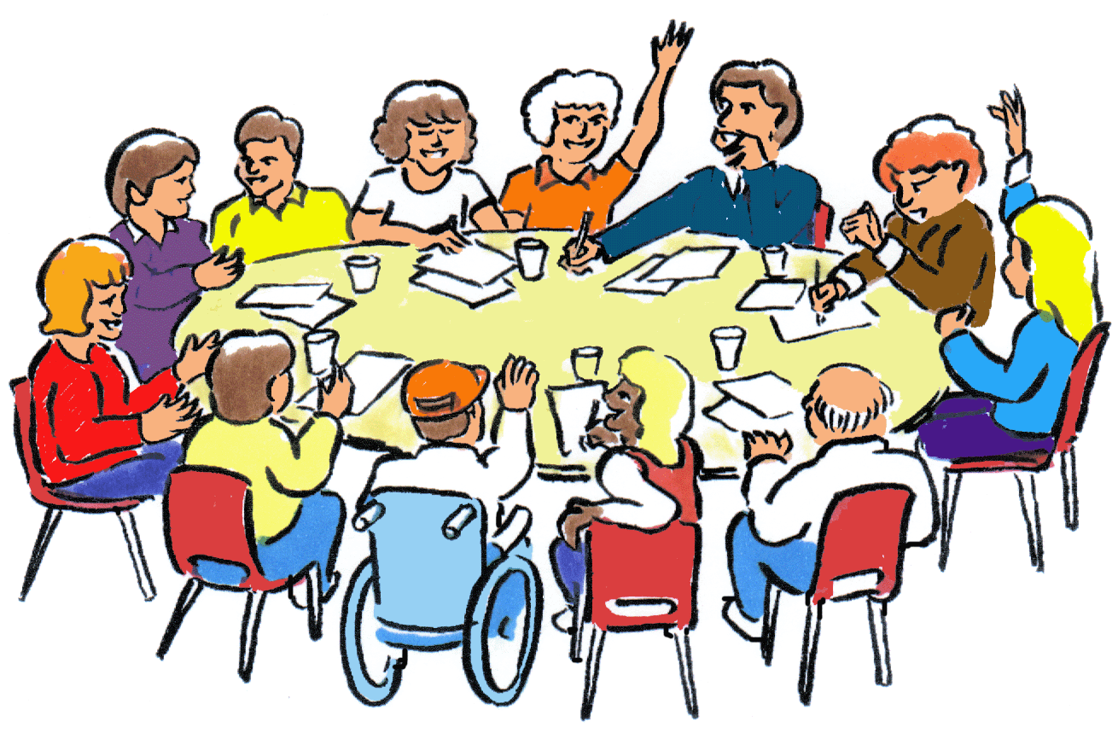
M – DAY
Greeting
Seating
Materials
Starting
Program
“Closing” the Sale
Notes:
You need a Glad-Hander GREETER at the door. A very friendly 1STcontact to impress the guests. Your members also need to be up and circulating about the room.
Everybody must have a name tag and offer them something to drink.
SEATING, hopefully the sponsor will sit with the guest. Also MAKE SURE there are not any tables with just guests. Consider pre-assigning a few members to each table so the guests have to fill-in the gaps.
There should by Agendas & the Prospects Package on the table for each guest. Remind your members to explain what is happening as the evening progresses.
D. This is a Lions meeting, so the President needs to get things started and follow the usual Agenda, beginning with the Pledge and then the Invocation. Make sure it non-denominational.
We all know how to eat, so get started………………….
At the end of the meeting, thank them for attending and let them know you would be glad for them to be a member to continue providing service to the community and internationally.

Slide 17

FOLLOW - UP
Thank you for -----
    Joining the Lions Club
    Coming to the Meeting
    Thinking about Coming to the Meeting
Follow-up Calls
Notes:
After the Meeting Letters need to be sent to different groups of people. Samples are provided in the Reference section.
- the people who actually joined.
- people who attended but didn’t immediately join.
- those you expected but didn’t see at the meeting.
Follow-up calls also need to be made, hopefully by the sponsor.
You keep after EVERYONE until they either join or you get a definitive “no.”
OTHER FACTS
- run a drive every year, twice per year for small clubs.
- success rate = 50 to 3 or 4
50 names x .4 = 20 agree to come
20 called x .4 = 8 appear at meeting
8 x .4 or .5 = 3 or 4 join your Lions club

Slide 18
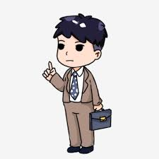
Other points to keep in mind…
District and State Global Membership Teams are available to assist your club
The Ohio Plan is on the Ohio Lions website; www.ohiolions.org. Go to Committees, then click on Global Membership Team then see attachments box and The Ohio Plan (revised February 2017) is there.
If your club does not have Audio/Visual Equipment check with your District GMT representative
Notes:
Some other things you should consider is that your District and State Global Membership Teams (GMT) are here to help. They want you to have a strong active club.
Your GMT Teams have promotional resources that would be useful for a Lions membership night such as recruiting DVD’s and other information which explains further what Lions Clubs International is all about.
The team may also know how your club can obtain audio visual equipment for use at your meeting

Slide 19

RETENTION
What can you do to retain members:
  Get them involved!
    Chair or co-chair a committee
    Listen to their ideas/implement it/try it
    Install them as an officer or a co-officer
    Make them a valued member of your club
    Be welcoming, sit with them, get to know them, be respectful
Notes:
We have to retain our members, or we don’t continue to grow. Now, I am sure you are wondering how you make this happen. Find out what they like to do and get them involved. Have them be a chairperson or co-chairperson of a committee. Find out what their ideas are and try it; you never know what will be successful even if you tried it before. Times change and with the right excitement and person interested in running it or helping, this could be a huge success. Ask them to be an officer or on the board; they can be a co-Lion Tamer, co-Tail Twister to give them a stake in your club and it helps to provide them with ownership of their club. Make members feel valued; listen to them and use their strengths. When you get new members, be welcoming, go sit with them and really get to know them. Be respectful of all our Lions and make them feel like they are part of the Lions team. You can even mention something that you find out about them. Seek and we will find.
We can’t keep doing what we have been doing. Being friendly goes a long way in keeping people around.

Slide 20

RETENTION (Cont)
    Do the Community Needs Assessment
      Helps with ideas for new service projects to attract new members and retain seasoned members by getting projects they like
    Do a membership satisfaction survey
      Located in the back of the Membership satisfaction guide. ME-301
    Orientations
      Do new member orientation upon joining. Do short orientations at monthly meetings to help new members and refresh current members.
Notes:
Do the Community needs assessment. This should help in coming up with new service projects to attract new members and retain seasoned members by getting projects they would like to work on.
Do a membership satisfaction survey. One can be found in the back of the Membership satisfaction guide. ME-301. Find out how satisfied our members are and what suggestions they have.
Conduct Good Orientations. Do new member orientation soon after they join the club. Then you should do short orientation programs at monthly meetings to help the new members and to keep our seasoned members refreshed.

Slide 21

RETENTION (Cont)
  Flexible in attendance at meetings
    Other family commitments and activities happen.
    Attendance at fundraisers and service projects are as important as attending regular meetings
  Members with children
    Involve children in activities and meetings. Ask the older youth to do activities with the younger ones. Lions Family Cub program MPFM34 9/09
  Members who have been a Lion for awhile
    Don’t burn them out and don’t ignore them-- there is always a job for a Lion.
Remember - Retention is as important as recruiting new members
Notes:
Be flexible in attendance at meetings. Other family commitments and activities do come up. Attendance at fundraisers and service projects are as important as attending regular meetings if there are problems getting to regular meetings. With the ability to send emails, we should be able to send out information to those not attending meetings that is important.
Members who have children. Involve the children in activities and meetings. Maybe you can get the older youth to do activities for the younger in another room. Review Lions Family Cub program MPFM34 9/09.
With older members. Don’t burn them out or don’t ignore them. There is always a job they can do.
We must retain our members as well as recruit new members to continue to function as Lions of Ohio and doing the great things that we do.

Slide 22
Questions???
THANK YOU
Notes:
Are there any questions? (Note: If you do not know the answer to a question, take an action and get back to them).
Also, do you have any ideas/suggestions?
Thank you so much for being here to learn about the Ohio Plan and how to help retain our current members. Please feel free to contact me at anytime if you have questions or ideas.
Remember, that “If we aim at nothing, we will hit it”

