Slide 1
LIONS USA/CANADA FORUM
PRESENTED BY:
PCC LYDIA HOUSER
937-609-6594 CELL
LMHYOYO@AOL.COM

Slide 2
Mission Statement
To develop leaders, motivate and educate attendees, provide an open exchange of ideas, and support programs and goals of Lions Clubs International

Slide 3
HISTORY
Began in 1977
The idea of the Forum came from Lions International President, Joe McLoughin
First Forum in Rosemont, Illinois
Ohio has hosted the Forum twice
2006
2018
Forums are in different locations each year

Slide 4
REGISTRATION
Set Cost to Register
Numerous Hotels to Choose
Pre-Set Prices
Receive Registration Packet Upon Arrival
Program of Events (Rules of Procedure, Major Forum Sponsors, Officers & Board of Directors, Forum Planning Committee, Host Committee), Name Tag/Lanyard, Local Information, Etc.

Slide 5
WHAT DO YOU GET
Lots of Seminars (You Choose)
Lions University
Leadership
Fun Facts
Fundraising
Service Projects
Etc.

Slide 6
WHAT DO YOU GET (Cont)
Lions University Graduation
Meet USA/CA International Directors/International Family
Featured Speakers in General Meal Sessions
Tables hosted by International Officers
Forum Store
Exhibitors
Perform Service Activities

Slide 7
Forum Tips HOW TO GET THE MOST OUT OF ATTENDING
◼ Plan your day in advance (which seminars you want to attend, when to visit the Forum Store, Exhibitors, etc.)
◼ Be flexible based on comments from others
◼ Wear comfortable shoes and clothing – Lions attire
◼ Network with Lions from all across North America
◼ Friday evening – no Forum program, open for enjoying

Slide 8
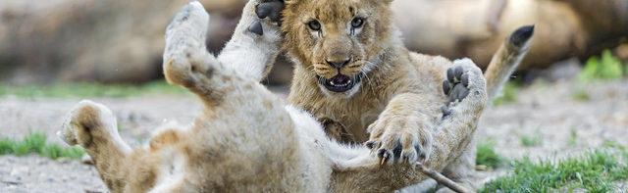
Days are busy, but lots of fun!

